Slide 1
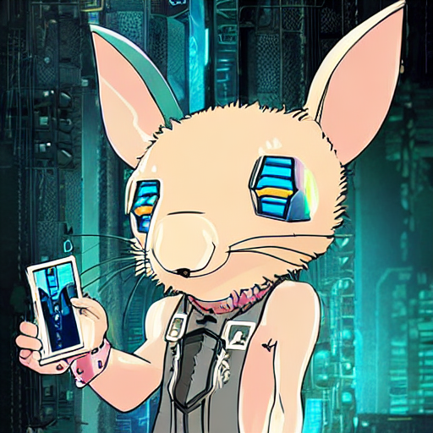
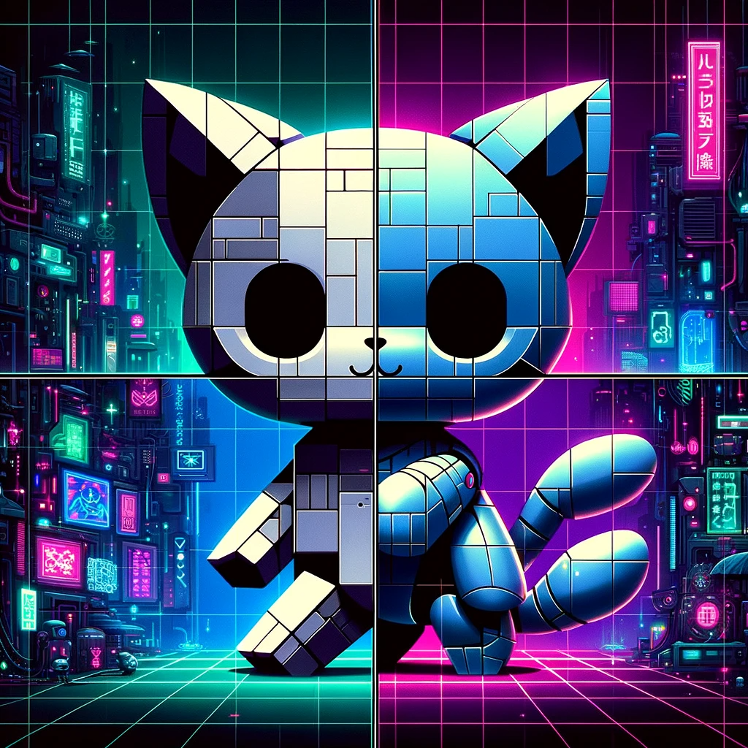
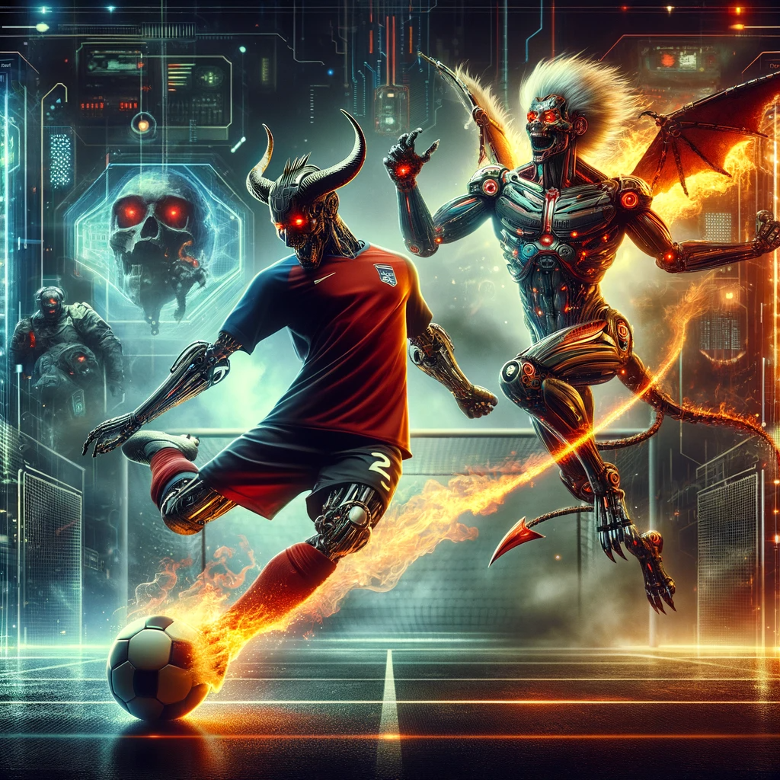
I’m kokist.
My icon was generated by stable diffusion.
The image below is my recent favorite generated by DALL-E 3.
Notes:
Hello everyone!
I’m kokist.
My icon was generated by stable diffusion.
The image below is my recent favorite generated by DALL-E 3.

Slide 2
Introduction to GitHub
GitHub is a web-based platform for version control and collaboration.
It allows developers to work together on projects from anywhere.
Built on Git, a version control system created by Linus Torvalds.
These sentences were generated by GPT-4o.
Notes:
Let’s talk about github.
GitHub is a web-based platform for version control and collaboration.
It allows developers to work together on projects from anywhere.
Built on Git, a version control system created by Linus Torvalds.
These sentences were generated by GPT-4o.

